Slide 1
Moving from Internationalization to Interculturalization
Todd Odgers
BCIT Associate Dean International

Slide 2
Today
Some context
Some guiding big ideas
Noticing when Something’s Up!

Slide 3
Presenters

Slide 4
Some numbers
494,525
130,000
4800

Slide 5
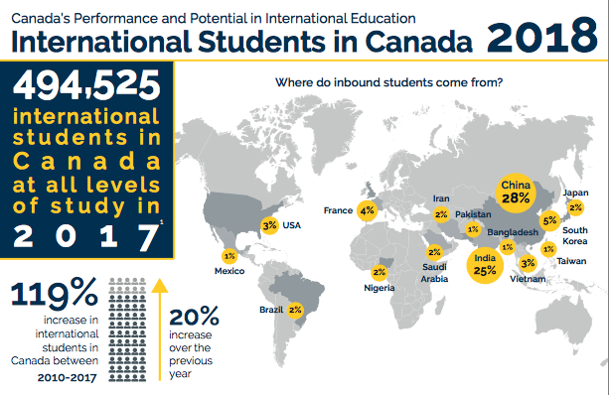

Slide 6
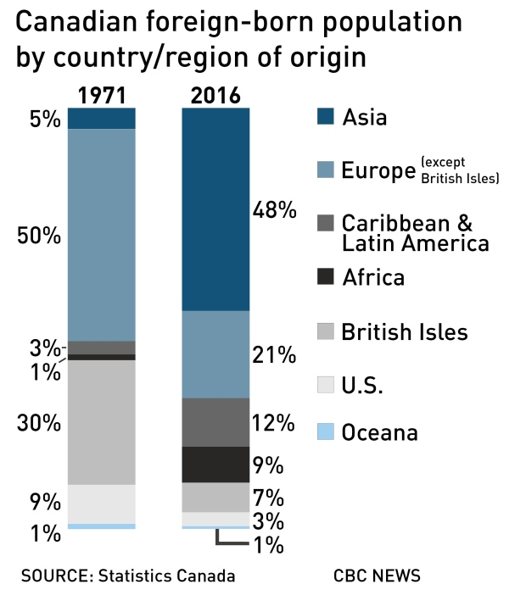
.
http://www.cbc.ca/news/politics/census-2016-immigration-1.4368970

Slide 7
The Interculturalized Experience
A curriculum which gives international and intercultural knowledge and abilities, aimed at preparing students for performing (professionally, socially, emotionally) in an international and multicultural context
Nilsson
Notes:
Knowledge-cognitive
Skills-behavioral
Attitudes-Affective

Slide 8
Contact Hypothesis
Groups from different cultures must be appropriately prepared to interact.
If they are not, then a reinforcement of stereotypes and prejudice is likely to occur.
Allport, G. W.
Pettigrew, T. F., & Tropp, L. R.
Notes:
Empathy
Understanding..
In teaching, curriculum phase when we confront differences.. Need preparation in order to interact; Culture A may be SO distant from Culture C due to language, geo politic, religion, prior contact, old blood, disposition; Some intercultural connections WILL require more work in preparation; leadership required here. Engaging deep differences; which is the wellspring of learning - best if you believe in appreciative perspective; open-mindedness. Stuff hits you comes out of lack of awareness. Buddhists say that three things block us: Ignorance, detachment and fear…. Transformative learning suggests that we work WITH these forces using self-awareness and self mgt…
Use elements from different cultures: Modeling - First nations learning circle, buddhist orientation, Chinese 5 elements; Brock’s parallel expressions

Slide 9
Cultural Distance
“The degree of psychological adjustment that is needed to bridge the dissimilarities between the culture of origin and the culture of entry.”
Ting-Toomey 1999

Slide 10
Noticing is step 1

Slide 11
Read aloud the following colors as fast as you can:

Slide 12
DO NOT READ the words, say aloud the COLOR of each word.
YELLOW BLUE ORANGE BLACK RED GREEN PURPLE YELLOW RED ORANGE GREEN BLACK BLUE RED PURPLE GREEN BLUE ORANGE

Slide 13
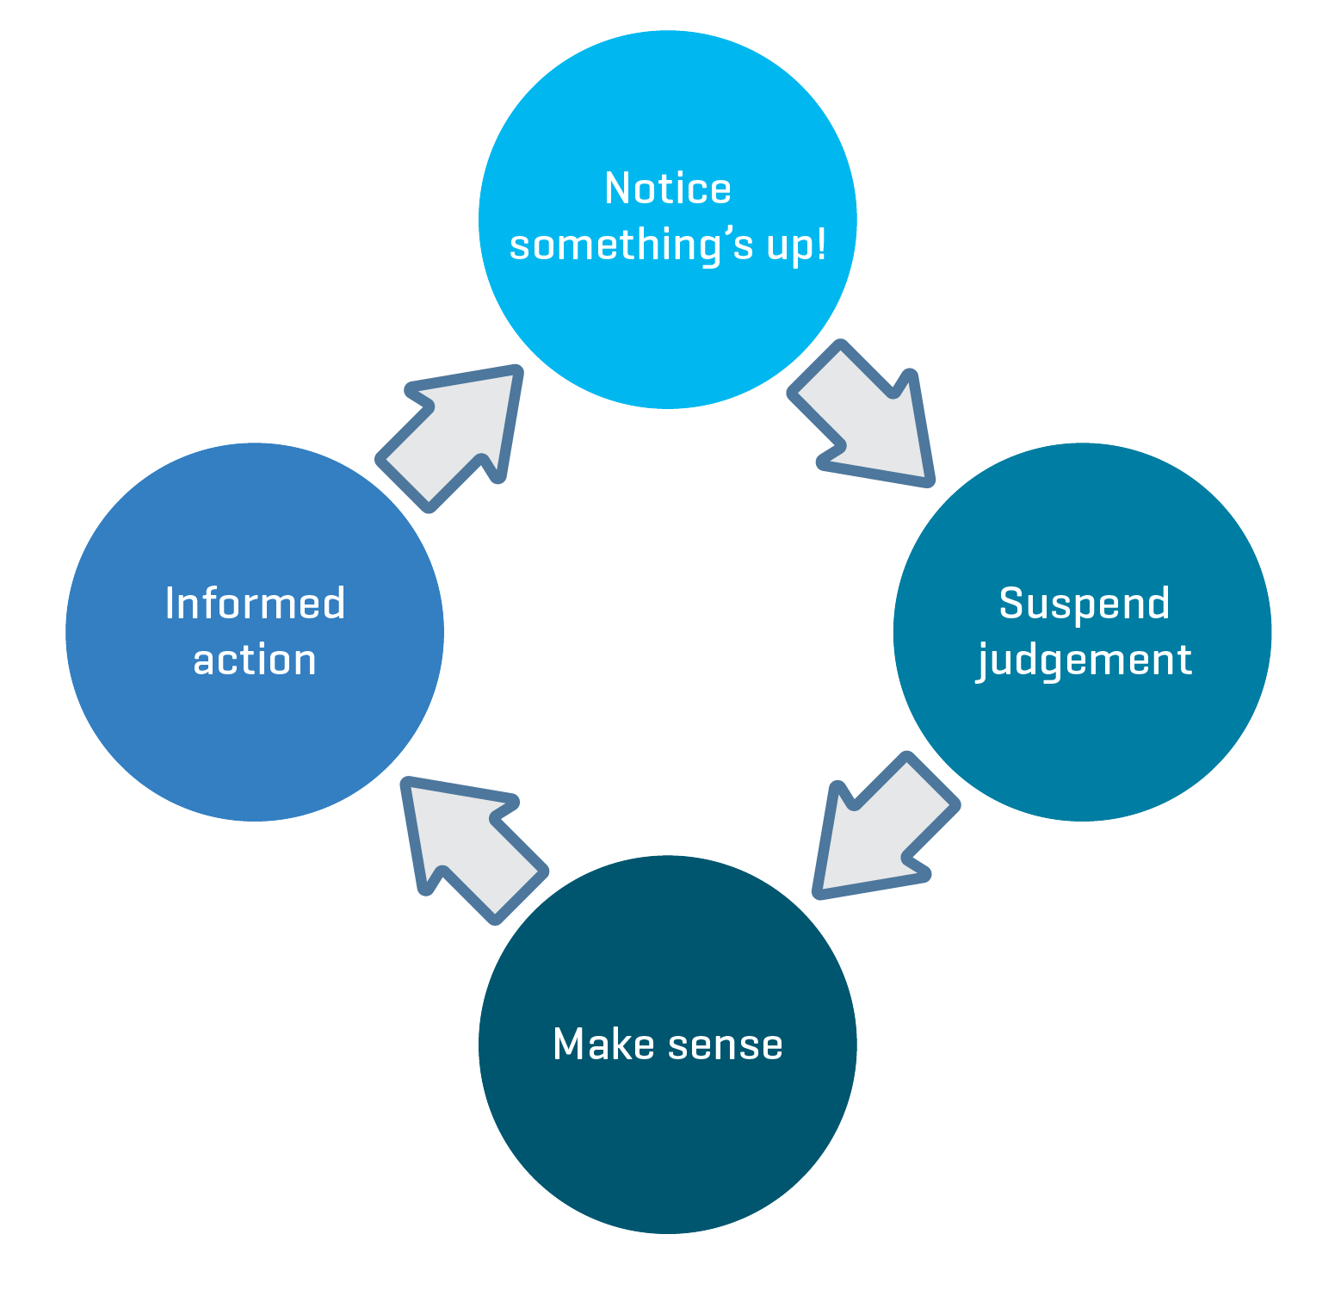
Something’s Up Cycle

Slide 14
Two Definitions
Intercultural sensitivity
The ability to discern and experience relevant cultural differences in a positive way
Intercultural competence
The ability to think and act in appropriate ways that support the achievement of goals in culturally diverse contexts

