Slide 1
Conflict Resolution: Tools for the Workplace
for Students of Durham College’s
Dental Hygiene Program
Your Facilitators: Dale Burt & Caitlin Jacobs

Slide 2
Here’s where we’re going:
Distinguish positions from interests in conflict.
Explore why it is VERY important to focus on interests (not just positions) for effective conflict resolution.
Q & A time… what are you wondering?

Slide 3
The potential for conflict exists anywhere there are people interacting.
Many of us wish we never had to deal with conflict as it can be very challenging.
Conflict resolution is a learned skill! We can acquire skills to de-escalate and prevent conflict.

Slide 4
Perfection is NOT Required
There is no one perfect way to handle conflict. It’s a highly personal and subjective process.
Each conflict interaction is unique ~ as are you, the other person, and the specific circumstances.

Slide 5
We know WHAT each wants
(their position).
We also need to uncover the WHY (their interests).

Slide 6
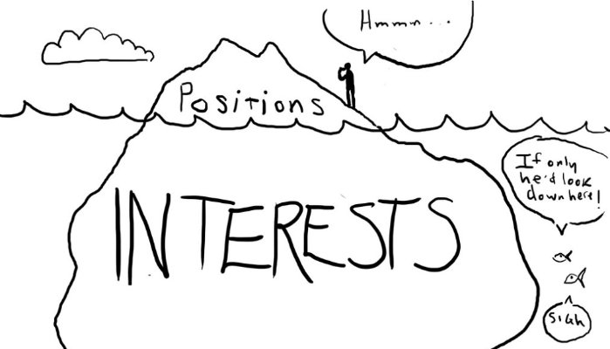

Slide 7
Position & Interest(s)
What they want
Overt
Often stated
What’s demanded
Why they want it
Covert
Often hidden
Needs & values

Slide 8
To get to a desirable outcome, it is paramount to identify interests (not only the positions).
Understanding interests helps us to build durable, lasting, effective agreements.

Slide 9
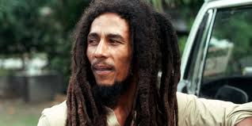
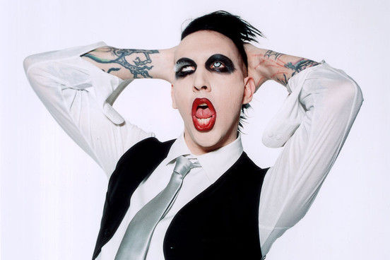
Let’s Practice The New Neighbours: Bob and Marilyn
Image from bobmarley.com
Image from musicenthusiastmag.com

Slide 10
To identify Interests:
Why does he/she want that?
What is really going on behind his/her words?
What is his/her underlying concern here?
What does he/she need to feel better?

Slide 11
Your next dental client is waiting. He is a 42 year old male who has not been to a dentist nor a dental hygienist in over 10 years. You are running late. You come into the waiting room to get him and you notice he is red-faced and seems agitated. You greet him, saying “good morning!” He stands up abruptly, huffing and puffing, he says to you “Whatever! I want to cancel my appointment!”
You want to de-escalate this potentially volatile conflict situation.
What is his position (what does he state that he wants)?
What might be his interests (his true concerns, his real needs behind his position)?

Slide 12
?
What is one important thing you learned today during this lesson?
What’s one question you have?
?
?

Slide 13
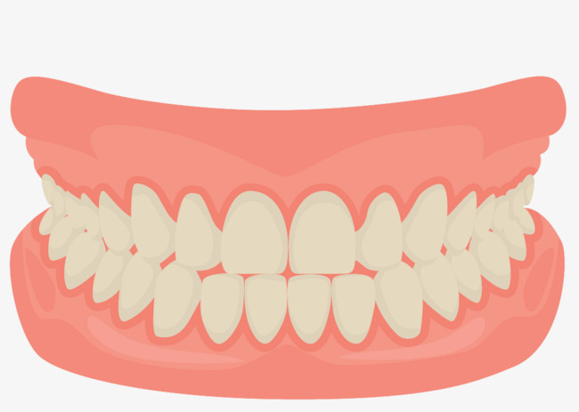
Thank you for inviting us!
Dale Burt & Caitlin Jacobs
CCRS@durhamcollege.ca

